Slide 1
Two Factor Authentication
TEAM MEMBERS:
Jahnavi Dammannagari
Sailaxman Janumula
Nikitha Srivyshnavi Kankanalapalli
Sai Tejaswee Vissapragada
Archana Lingampally
Abdul Rehman Sayeed Mohammed
Shahid Mohammed
Shiva Krishna Myakala
Dheemanth Reddy Sanku
Manikanta Vasana
1

Slide 2
Outline
Introduction
Proposed Solution
Block Diagram
Project Requirements
Reference Framework
Future Accomplishments
Gantt Chart

Slide 3

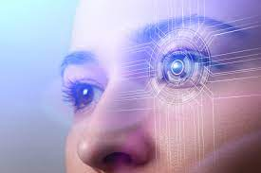
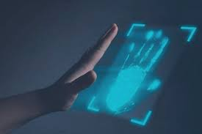

Introduction
Fingerprint Authentication
Iris Authentication
Palm Authentication
Voice Authentication

Slide 4
Why Heart Wave Authentication?
High security and assurance – Biometric identification provides the answers to “something a person has and is” and helps verify identity
User Experience – Convenient and fast
Non-transferrable – Everyone has access to a unique set of biometrics
Spoof-proof – Biometrics are hard to fake or steal

Slide 5



Proposed Solution
Scan QR code for authentication
QR Authentication
Heart wave Authentication
Employees of organization
Detect Heart wave for authentication
5

Slide 6
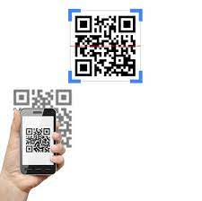
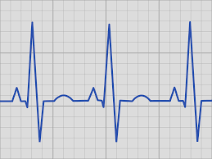

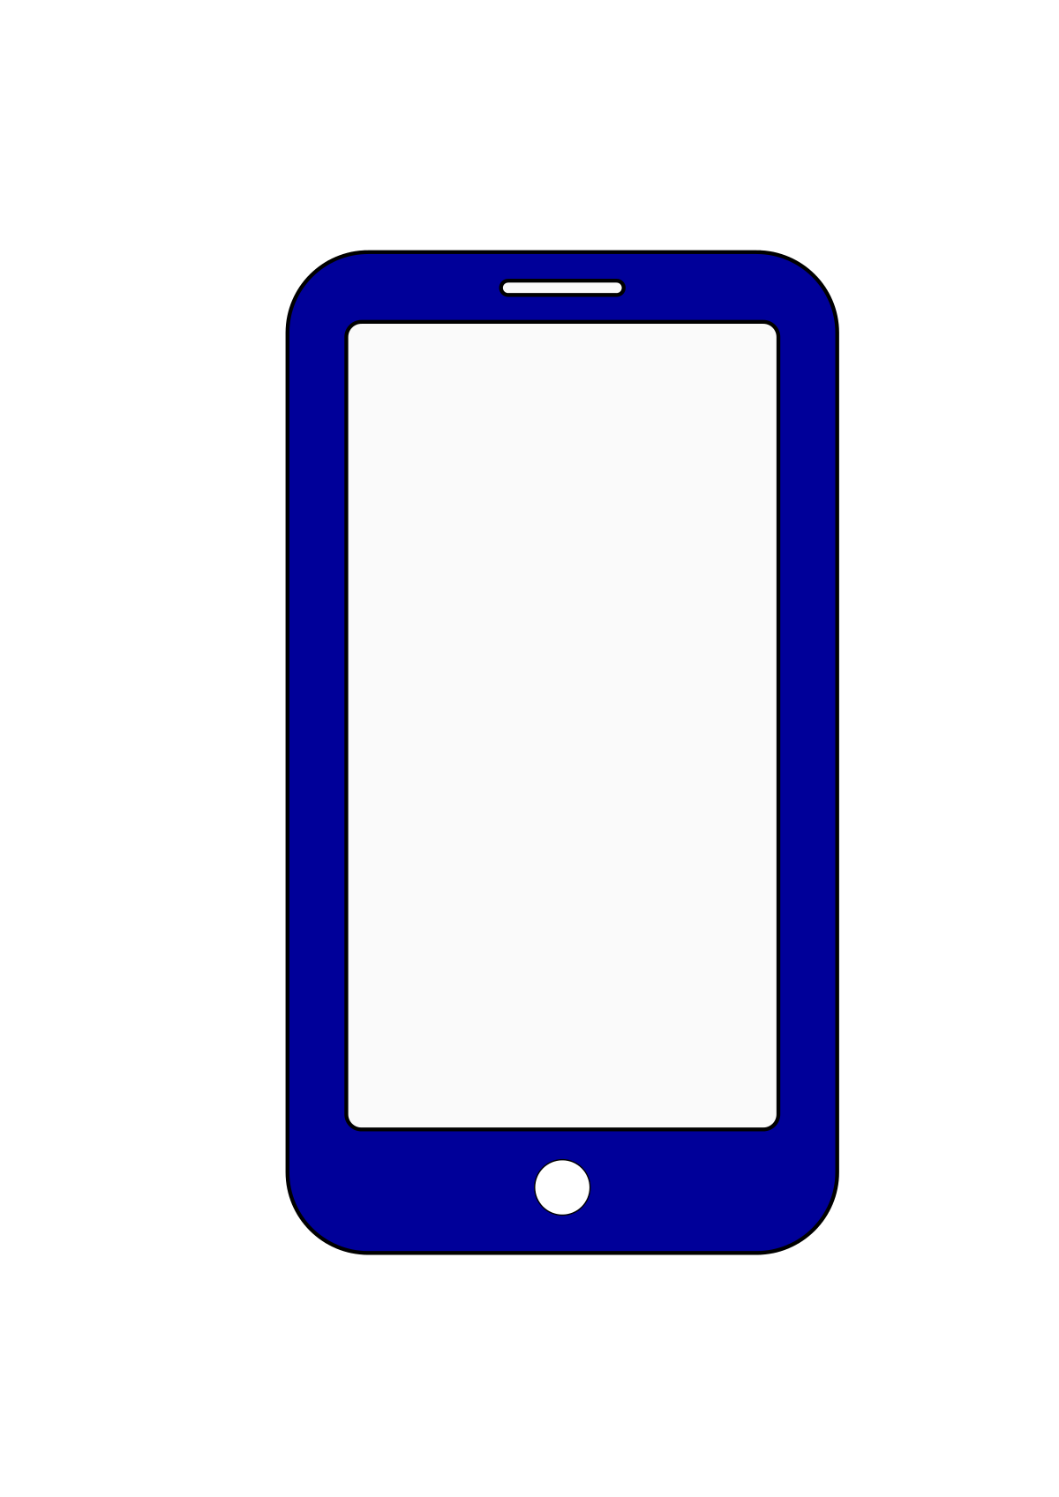
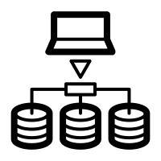
Block Diagram
Access Granted
QR Code is Scanned
ECG wave is detected
User
Access Granted
Heart wave Authentication
Services

Slide 7
Project Requirements(Admin and System)
Requirements | Requested By Stakeholder
Login page | Admin
Create New User | Admin
Generating QR Code | Admin
Delete Existing User | Admin
Verifies the QR Code | System
Verifies the Heart wave | System
Gives access to organization after two factor authentication | System

Slide 8
Project Requirements(User)
Requirements | Requested By Stakeholder
Login | User
Scans the QR Code | User
Detects the Heart wave | User

Slide 9
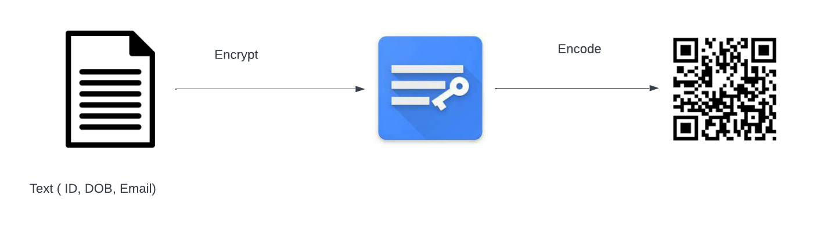
Reference Framework for QR Code

Slide 10
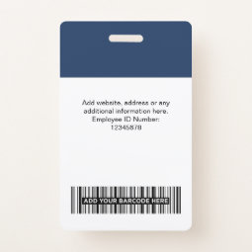
Reference Framework for QR Code
ID card issued with QR Code :
An ID will be issued having the QR to scan during the authentication.
To scan the QR codes, we will use OpenCV library to read the input images and video streams and display the outputs.
To decode the codes, we will use the pyzbar and zbar
libraries.
We will also need the NumPy library to work with
multi-dimensional arrays and matrices.

Slide 11
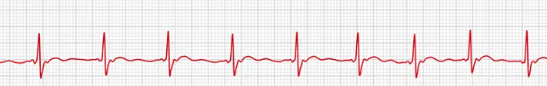
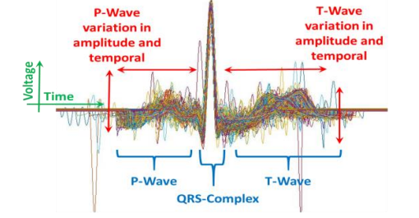
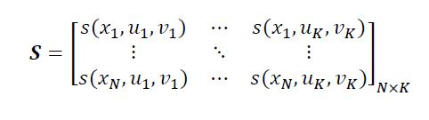
Reference Framework for heart wave
Graph
Person 1
Data
Preparation
Graph
DBN
Graph
Person 2
…
DBN
Superimposition
Graph
Features along with noise
Person 52
Features are
converted into matrix
Noise is eliminated
ELM
MSE
MSE
52 matrixes are extracted
Required features are retained
Notes:
GitHub - GitHub Inc. is a web-based hosting service. It is mostly used for storing, sharing and retrieving computer code. GitHub offers plans for both private repositories and free accounts. In our project we have created a private repository (using a student account) and added all the team members along with Hemanth. We have created a developer branch for our repository so that all the commits are made to the developer instead of the main branch to avoid any conflicts.
Postman - Postman is a powerful HTTP client for testing web services. Postman makes it easy to test, develop and document APIs by allowing users to quickly put together both simple and complex HTTP requests.
MongoDB Compass – MongoDB Compass is a GUI which displays the information about the MongoDB database and can also be used to perform queries.
Visual Studio Code - Visual Studio Code is a source code editor. It supports a number of programming languages and a set of features that may or may not be available for a given language.
TortoiseGit - TortoiseGit is a Git revision control client, implemented as a Windows shell extension (free software). Besides showing context menu items for Git commands, TortoiseGit provides the status of Git working trees and files. It also comes with the TortoiseGitMerge utility to visually compare two files and resolve conflicts.

Slide 12
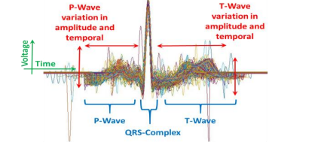
Data Preparation
The heart wave of each individual is independently delineated and extracted. The delineation process uses Discrete Wavelet Transform (DWT) with a fourth order Daubechies wavelet (DB4) to achieve heart wave delineation.
Superimposition of all extracted heart waves of an individual

Slide 13
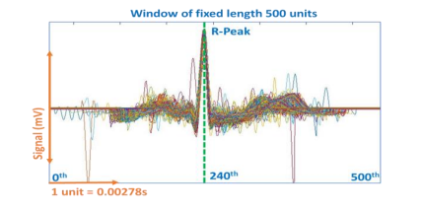
Data Preparation
Heart wave signals from all 52 individuals consisting of 75,188 heart waves are successfully extracted. Of the 52 graphs, Superimposition of all extracted heart waves of an individual aligned around R-Peak. P-Wave and T-Wave show the morphological changes at varying heartrate. 4 individuals, there are 5 individuals with inverted T-Waves. To further prepare the heart waves for subsequent ensemble Deep Belief Network (DBN) training, each of the heart wave is aligned inside a fixed window of length 500 unit.

Slide 14
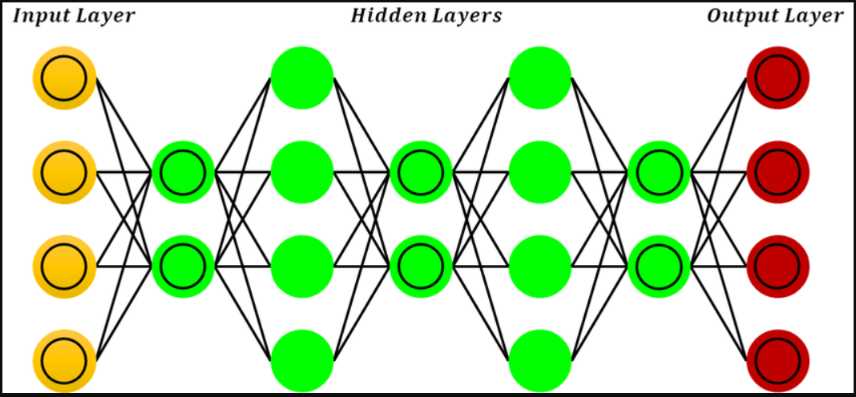
Deep Belief Network
A deep-belief network (DBN) is built by appending a stack of RBM layers. In the stack every RBM layer can communicate with both the previous and subsequent layers. Hence it is a network which is assembled out many single-layer networks. Except the first and final layers every layer in a DBN performs a dual role by serving as the hidden layer to the nodes that come before it and as the input layer to the nodes that come after.
Deep Belief Network Functionality

Slide 15
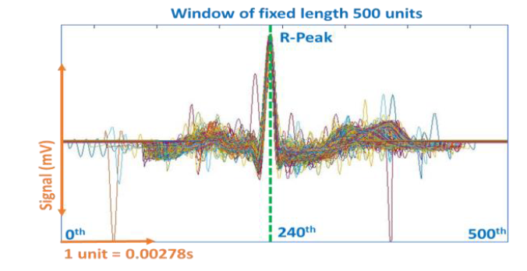
Deep Belief Network
The extracted graph data from the data preparation stage is given as input to the DBN and the output will contain extracted features under different DBN Configurations. The output also contains some irrelevant features and contribute to the misclassification rate of data.
We use DBN for extracting the features from the graphs and to input it to the Multi View Spectral Embedding.
Features including irrelevant data
Input
output

Slide 16
Multi-View Spectral Embedding
The output of the ensemble- DBN contains features extracted from various DBN configurations.
Moreover, the output also contains features that are irrelevant and contribute to the low rate of misclassification of the training data.
The use of Multiview Spectral Embedding (MSE) is an efficient approach to combining ensemble-DBM representations.
Which also Identifies and embeds additional properties of each view to form a single view.

Slide 17
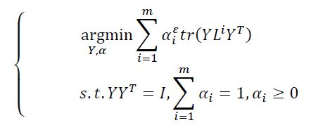
Multi-View Spectral Embedding
Each of 52 datasets is individually input to MSE to determine the contribution factor 𝛼 of each user specific view 𝛼=[𝛼1,…,𝛼𝑚] where m refers to the number of DBNs in the ensemble-DBN.
As MSE module is managing multiple views, there is a need to assign a weight factor to each of the represented views. This is to ensure that only complimentary property from multiple views contributes to the final embedment.
Based on Ky-Fan theorem, has a global optimal solution when 𝛼 is fixed.
With the optimized 𝛼𝑖obtained, it is multiplied to the penultimate layers of the respective views and summed. This ensures that for each user, only significant complementary property is amplified. This process is appliesd to all users.

Slide 18
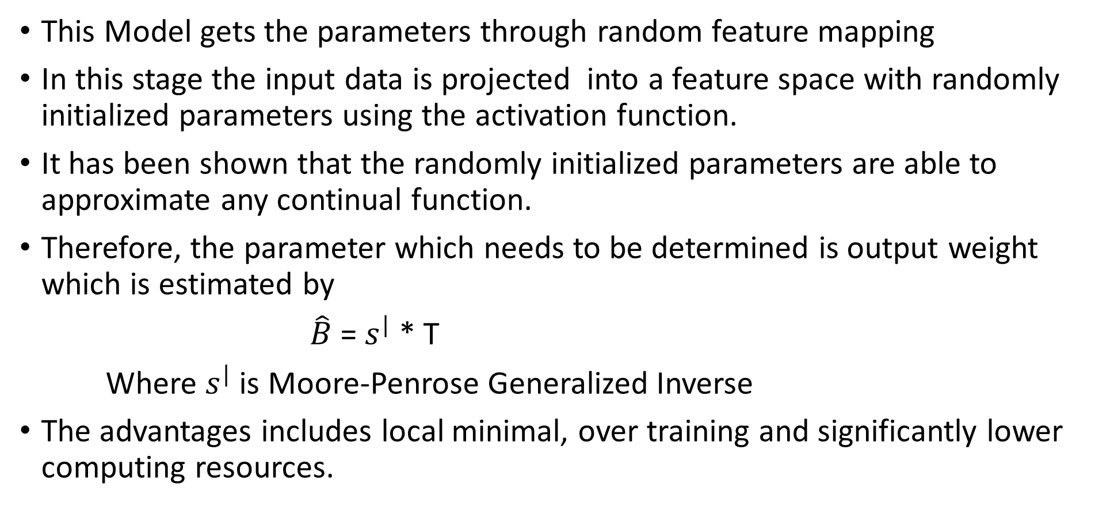
Extreme learning machine
This Model gets the parameters through random feature mapping
In this stage the input data is projected into a feature space with randomly initialized parameters using the activation function.
It has been shown that the randomly initialized parameters are able to approximate any continual function.
Therefore, the parameter which needs to be determined is output weight which is estimated by
$\hat{B}$ = $s^{|}$ * T
Where $s^{|}$ is Moore-Penrose Generalized Inverse
The advantages includes local minimal, over training and significantly lower computing resources.

Slide 19


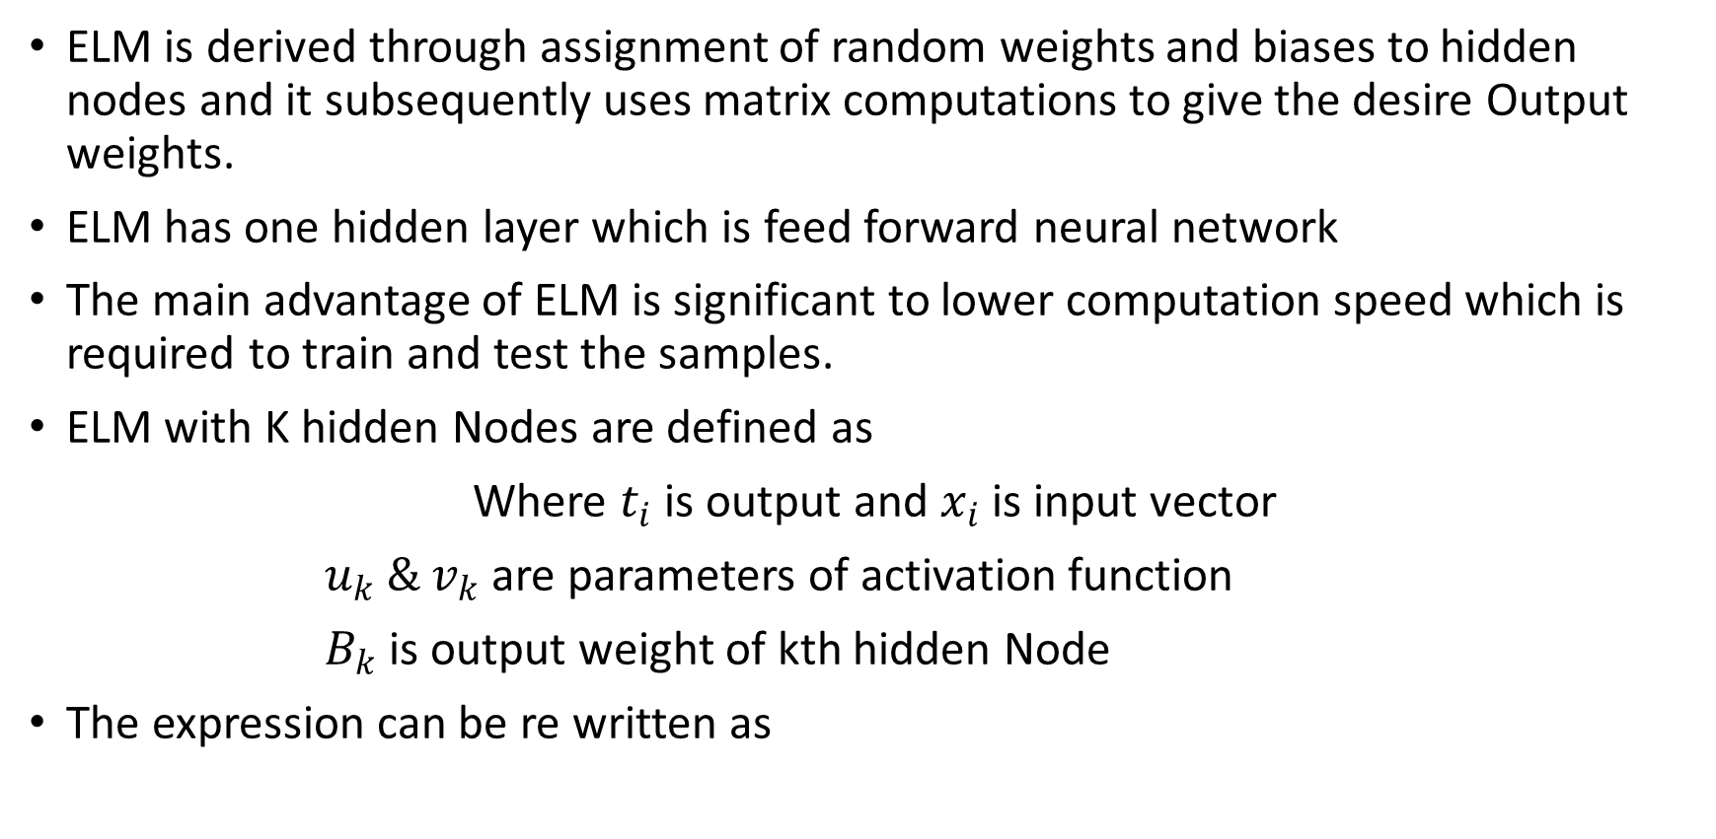
Extreme Learning Machine
ELM is derived through assignment of random weights and biases to hidden nodes and it subsequently uses matrix computations to give the desire Output weights.
ELM has one hidden layer which is feed forward neural network
The main advantage of ELM is significant to lower computation speed which is required to train and test the samples.
ELM with K hidden Nodes are defined as
Where $t_{i}$is output and $x_{i}$ is input vector
$u_{k} \& v_{k}$ are parameters of activation function
$B_{k}$ is output weight of kth hidden Node
The expression can be re written as

Slide 20
Future Tasks to be accomplished
We are going to deploy the application on Heroku.
And front end will be made using flask to create log in details when a user try to log in with the correct user credentials a QR code is generated.
The QR code is generated using python.
The QR code is unique to the user.
In the future we will try to authenticate it with the heart wave.

Slide 21
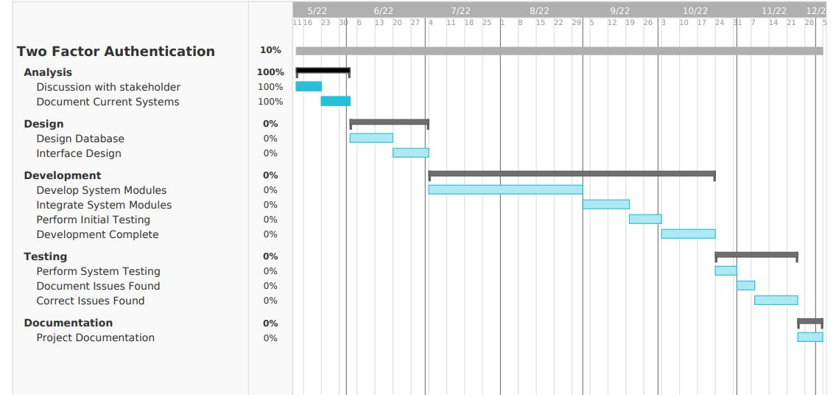
Gantt Chart

Slide 22
Thank You

